Slide 1
Warm Up and Stretches
Sports Science

Slide 2
Badminton
Here are a selection of stretches that you can use for your badminton warm up. Hold each of the following stretches for 10-20 seconds, and remember to stretch both sides of the body. There are links to more detailed information about each stretch.

Slide 3
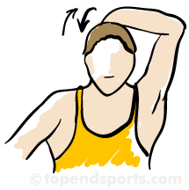
1. Front & Back Neck Stretch
Tuck your chin down until it touches your chest and you can feel tension at the back of your neck. Tip your head to each side slowly until you feel the stretch.

Slide 4
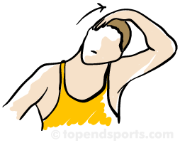
2. Side to Side Neck Stretch
Tuck your chin down until it touches your chest and you can feel tension at the back of your neck. Tip your head to each side slowly until you feel the stretch.

Slide 5
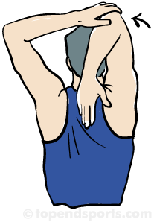
3. Overhead Shoulder Stretch
Point your elbow upwards, with you hand behind your head. With you other hand grab your elbow and gently pull towards the other side until a good stretch is felt. Repeat for both sides

Slide 6
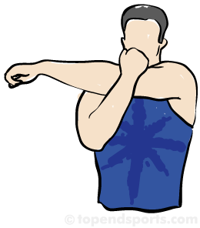
4. Posterior Shoulder Stretch
Hold you arm horizontally across the front of your body. With you other hand, grab your elbow and gently pull towards your chest. Repeat for both sides

Slide 7
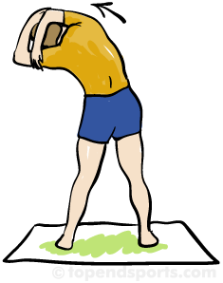
5. Side Trunk Stretch
Begin with feet slightly apart, and arm pointing overhead, held by the opposite hand. Keeping your hips stable, bend your torso so that the stretch is felt along your side. Repeat for both sides.

Slide 8
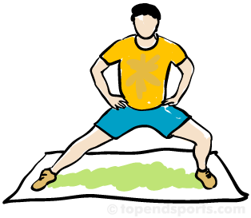
6. Side Lunge Stretch
This will stretch your hip adductor muscles. With you body and feet all facing forward, and hands on hips. Shift your weight tot he side, remaining as upright as possible and keeping both feet flat on the floor. Repeat on opposite side.

Slide 9
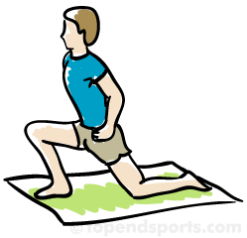
7. Forward Lunge Stretch
This will stretch your hip flexors and hamstring muscles. With you body and feet all facing forward, place one leg back and your other leg forward, hands on the front thigh. Shift your weight forward remaining as upright as possible and keeping both feet flat on the floor. Repeat on opposite side.

Slide 10
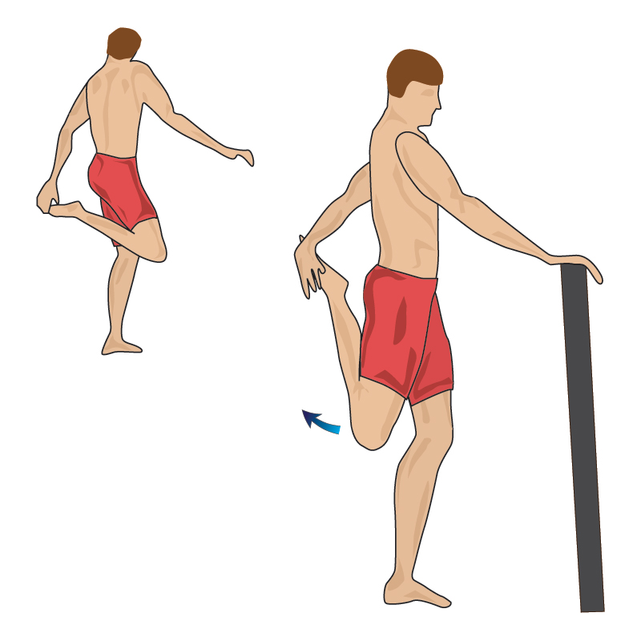
8. Quadriceps Stretch
Support yourself with one hand while standing on one leg. Bend your free leg back and hold on to your ankle with your free hand. To increase the stretch, pull the foot higher behind the body.

Slide 11
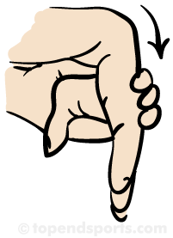
9. Wrist Flexion Stretch
Hold out your arm with the palm facing down. Drop the fingers and palm at the wrist. Grab your fingers with the other hand and pull them towards the body. Change hands and repeat.

Slide 12
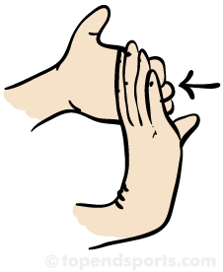
10. Wrist Extension Stretch
Hold out your arm with the palm facing down. Bend the fingers and palm at the wrist. Grab your fingers with the other hand and pull them back and towards the body. Change hands and repeat.

